Slide 1
Overview of Research Activities for Hybrid Perovskites
M.K. Crawford
R.J. Smalley
N. Herron

Slide 2
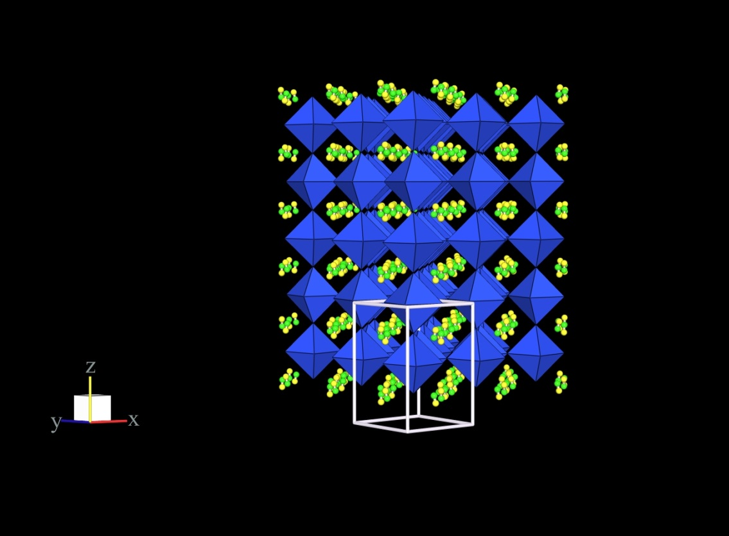
Hybrid Perovskites for Photovoltaics
Methyl ammonium lead halides
CH₃NH₃PbX₃ (X = Cl, Br, I)
Strong optical absorption
Direct semiconducting bandgap decreases with halide
E_{g}(Cl) = 3.1 eV > E_{g}(Br) = 2.23 eV > E_{g}(I) = 1.61 eV
X-ray structure of CH₃NH₃PbI₃
H atoms not observed

Slide 3
Hybrid Perovskite XRD
CH₃NH₃PbI₃
Cubic → Tetragonal: 330 K
Tetragonal → Orthorhombic: 161 K
CH₃NH₃PbBr₃
Cubic → Tetragonal I: 236 K
Tetragonal 1 → Tetragonal 2: 154 K
Tetragonal 2→ Orthorhombic: 149 K
CH₃NH₃PbCl₃
Cubic → Tetragonal: 177 K
Tetragonal → Orthorhombic: 172 K
CH₃NH₃PbBr_{0.75}I_{2.25} is cubic at RT
Br substitution has shifted the cubic→ tetragonal transition to near or below RT
Structural phase diagram to be determined

Slide 4
Hybrid Perovskite XRD
CH₃NH₃PbI₃
Tetragonal at room temperature
I4/mcm
MA disordered
CH₃NH₃PbBr₃
Cubic at room temperature
Pm3m
MA disordered
CH₃NH₃PbBr_{0.75}I_{2.25}
Cubic at room temperature
Cubic-tetragonal structural phase transition of MAPbI₃ has been suppressed by 25% Br incorporation by about 25%!
(check values for heat capacity and dielectric properties)

Slide 5
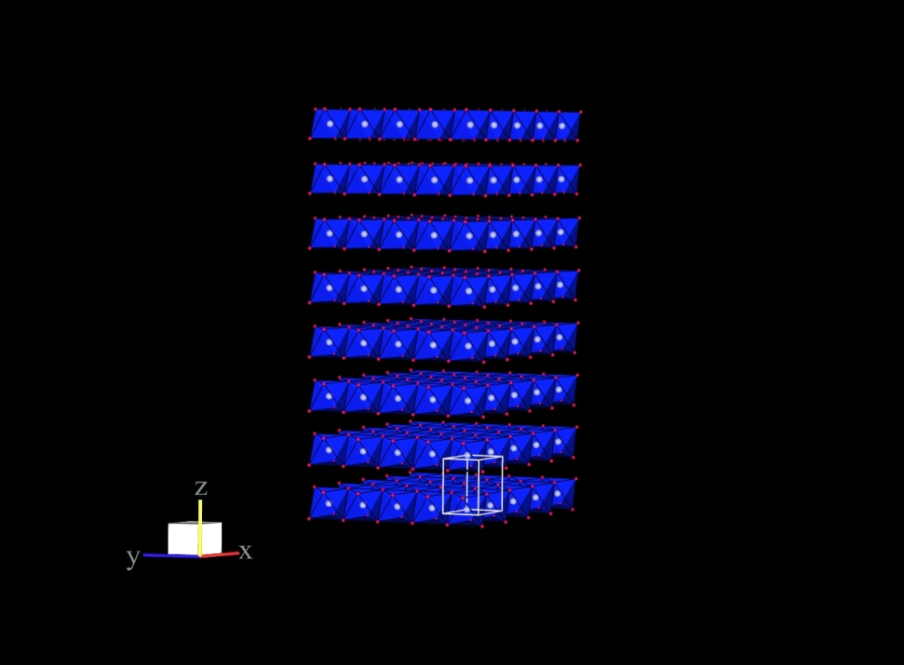
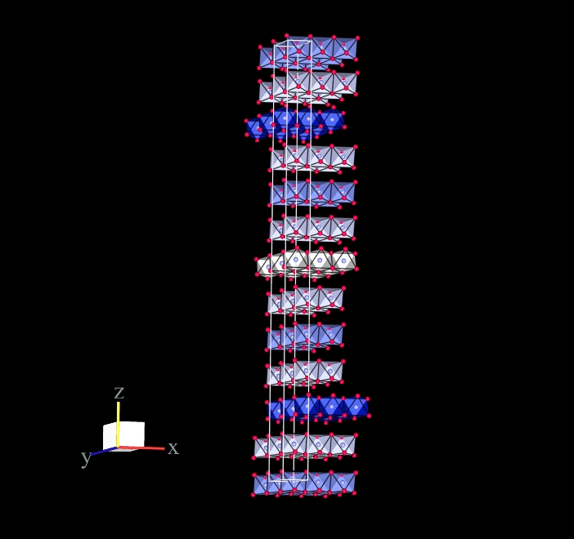
PbI₂ layered structures
P-3m1
R-3m
PbI₂
Layered structures
Different stacking sequences
P-3m1 symmetry
R-3m symmetry

Slide 6
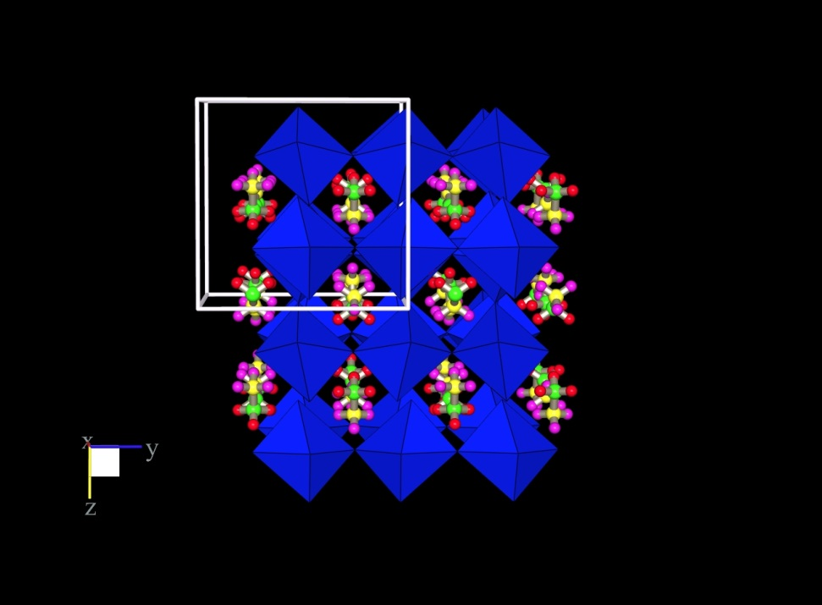
Neutron diffraction structure of low temperature phase of CH₃ND₃PbCl₃
Neutrons locate hydrogen/deuterium atoms
Neutron scattering length does not depend upon atomic number like x-ray
Hydrogen has a negative coherent scattering length and strong incoherent scattering (bad)
Deuterium has a positive SL and very little incoherent scattering
Neutrons can find MA cations (and distinguish C from N) and H/D atoms to evaluate H-bonds
CH₃ND₃PbCl₃ neutron structure at 80 K
MA cations fully ordered
Ian Swainson, Chalk River (2005)

Slide 7
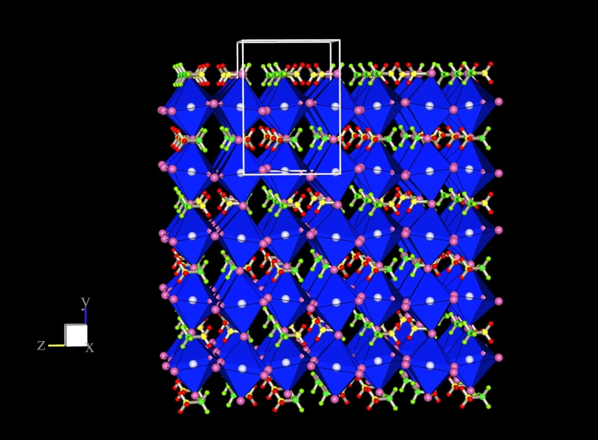
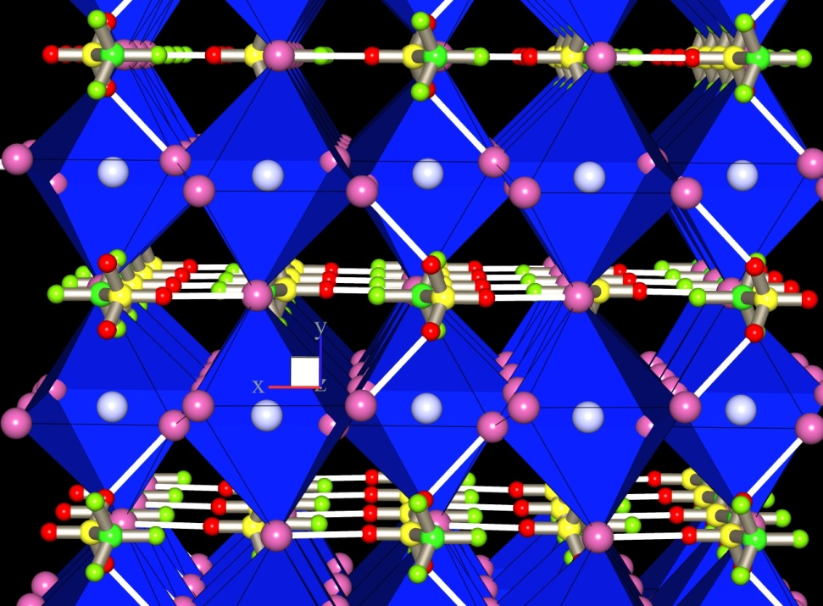
Hydrogen bonds in low temperature phase of CH₃ND₃PbBr₃
CH₃ND₃ cations are fully ordered at T = 11 K
ND₃-Br hydrogen bonds influence tilts of PbBr₃ octahedra
D-Br hydrogen bond length of 2.5 Å

Slide 8
Hybrid Perovskite Photoluminescence
Absorption of light above 1.6 eV bandgap generates electron-hole pairs
Bound together as excitons??
E_{B} ~ 25 meV (> kT at 300 K)
Exciton or e⁻ - h⁺ recombination generates PL
Tetragonal → Orthorhombic transition at T = 161 K
Longer wavelength spectra will be collected
InGaAs linear array detector
Search for levels deep within bandgap due to defects, dopants, etc.

Slide 9
Hybrid Perovskite Photoluminescence
Exciton recombination luminescence
Two bands have been assigned to orthorhombic and tetragonal phases
Coexistence at all temperatures?
No direct structural confirmation
DFT calculations by I. Milas will help assign transitions
Possible that intrinsic or extrinsic defects contribute

Slide 10
MAPbCl₃ and MAPbBr₃ Photoluminescence
MAPbCl₃ PL
375 nm excitation
Bandgap = 3.11 eV
MAPbBr₃ PL
532 nm excitation
Bandgap = 2.23 eV

Slide 11
Hybrid Perovskite Raman
785 nm excitation
Below bandgaps of MAPbBr₃ and MAPbCl₃ (but not MAPbI₃)
Internal vibrations of methyl ammonium groups are most prominent
Some are strongly broadened at room temperature
Significant static/dynamic disorder
Modes at 486 cm⁻¹ (MAPbCl₃) and 323 cm⁻¹ (MAPbBr₃)
Frequencies scale as [(m(Br)/m(Cl)]^{1/2}
Assigned to MA torsional vibrations
INS will determine if this is true

Slide 12
Hybrid Perovskite Raman
Pb-halogen vibrations are located at low energies
200 cm⁻¹ or less
Based upon comparison to vibrational frequencies of PbI₂, PbBr₂, PbCl₂
Expected near 100 cm⁻¹ for CH₃NH₃PbI₃
Vibrations broaden markedly above 174 K
Related to cubic → tetragonal phase transition at 177 K?
MA cations begin to orientationally order below this phase transition

Slide 13

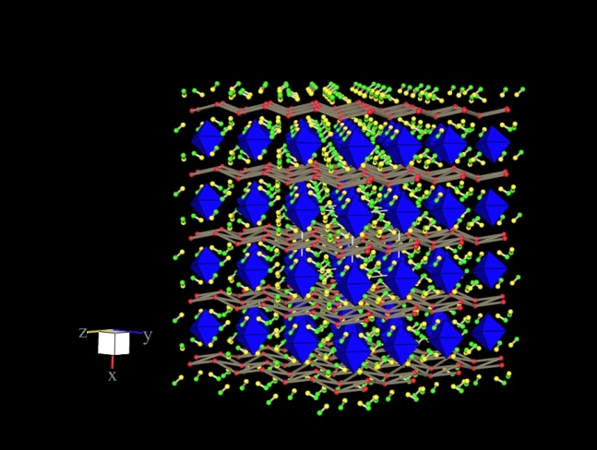
Decomposition of CH₃NH₃PbI₃ One possible reaction with water
(CH₃NH₃)PbI₃ + 2H₂O → (CH₃NH₃)₄PbI₆•2H₂O + 2PbI₂
Hydrate is yellow (isolated PbI₆ octahedra)
(PbI₂ may instead be an hydroxide such as PbIOH)

Slide 14
TGA Thermal degradation of bulk MAPbX₃ in N₂
CH₃NH₃PbBr₃
CH₃NH₃PbCl₃
CH₃NH₃PbX₃ → CH₃NH₃X + PbX₂
CH₃NH₃PbX₃ → CH₃NH₂ + HX + PbX₂
CH₃NH₃PbX₃ → CH₃X + NH₃ + PbX₂
TGA-MS is underway to evaluate pathways, as are same measurements on CH₃NH₃PbI₃
No evidence for retained solvent release
Data important for neutron scattering experiments at NIST next month

Slide 15
Future perovskite measurements
Neutron scattering
Inelastic → vibrations
Quasielastic → MA dynamics
Diffraction → structure
X-ray scattering
Structural studies
Complements neutron scattering
Infrared spectroscopy
Structural phase transitions in films
Decomposition chemistry of films
Raman spectroscopy
Structural phase transitions in bulk
Decomposition chemistry in bulk
PL and EL imaging of biased devices
Near-infrared PL

